Slide 1

Financial Business Use Cases Predicting the future isn’t magic, it’s artificial intelligence
.
Notes:
The Objective of this research
To forecast the construction of SFHs in United States, so that it guide construction business community about where to invest ahead of time. Past data can be used analyze complex patterns in SFHs construction across united states (US)
Once we get the prediction, now it is important to know the optimal locations where construction company build plants

Slide 2

With the enhancement in the banking sector lots of people are applying for bank loans but there are certain concerns from banks’ perspective
Problem Definition
.
Who is more suitable to grant loan, who will not default (Loan Default Prediction)
Application processing takes time, we should avoid wastage of time. Whether loan application will approve or denied (Loan Approval Prediction System)
How much loan should be granted to applicant based on his/ her attributes (Loan Amount Prediction)
How much loan applications can be submitted next Month? (Forecasting)
Whether the case is fraudulent or not? (Outlier/ Anomaly/ Fraud Detection System)
Notes:
The Objective of this research
To forecast the construction of SFHs in United States, so that it guide construction business community about where to invest ahead of time. Past data can be used analyze complex patterns in SFHs construction across united states (US)
Once we get the prediction, now it is important to know the optimal locations where construction company build plants

Slide 3
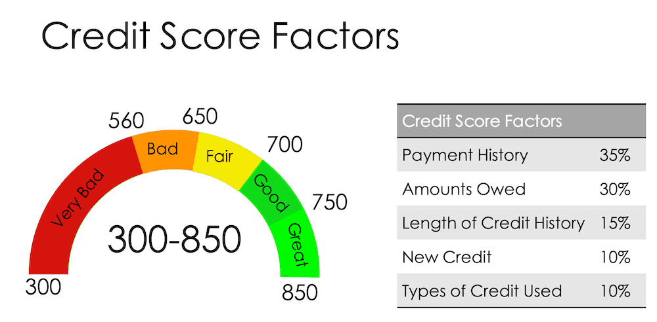
These are valid concerns of banks, and they are trying their level best to address such issues by using traditional credit scoring, which is worthiness points issued by a set list of providers, consider as gold standard for assessing a person or company’s credit worthiness. (FICO Scoring is an Example)
Current Banking Process
.
Notes:
The Objective of this research
To forecast the construction of SFHs in United States, so that it guide construction business community about where to invest ahead of time. Past data can be used analyze complex patterns in SFHs construction across united states (US)
Once we get the prediction, now it is important to know the optimal locations where construction company build plants

Slide 4
Okay, so the problem already fixed by Banking Sector, but using Credit Score (or other scoring techniques), which are mostly ruled based systems.
AI in Finance
.
By using past data, Machine learning can be leverage to extract hidden patterns/ insight from the data. That historic patterns will be then used to asses person/ company’s credit worthiness
Machine Learning not only using transactional data directly, but a lot of other type of data such as transactional behavior, demographic data, other external sources
Notes:
The Objective of this research
To forecast the construction of SFHs in United States, so that it guide construction business community about where to invest ahead of time. Past data can be used analyze complex patterns in SFHs construction across united states (US)
Once we get the prediction, now it is important to know the optimal locations where construction company build plants

Slide 5
.
Agenda
.
Data Exploration
Loan Approval
Forecasting
Anomalous Contractors
Notes:
The Objective of this research
To forecast the construction of SFHs in United States, so that it guide construction business community about where to invest ahead of time. Past data can be used analyze complex patterns in SFHs construction across united states (US)
Once we get the prediction, now it is important to know the optimal locations where construction company build plants

Slide 6


The company finance of America offer loans to home owners who want to do repairs in their home Home owner will apply for a loan to the company finance of America Finance of America have approved contractors The contractor will come see the problem and let you know it cost let say 25,000 dollars Upon mutual Agreement, home owner apply for a loan to finance of America From here the loan approval system process started, which involve many checks such as home owner credit history, monthly installments, Interest rate, requested Amount etc.
Data Exploration
.
Average 14 Days
Notes:
The Objective of this research
To forecast the construction of SFHs in United States, so that it guide construction business community about where to invest ahead of time. Past data can be used analyze complex patterns in SFHs construction across united states (US)
Once we get the prediction, now it is important to know the optimal locations where construction company build plants

Slide 7


Customers Needs Loan Quickly, but verifying customers can take time (Application to Accept/ Reject take 14 days on Average)
Issue with Scoring
.
Not considering other types of potential data (Historic Data)
You may lose potential customer due to lengthy process
Whether there is any Anomaly or Fraud, Scoring cannot tell us?
Notes:
The Objective of this research
To forecast the construction of SFHs in United States, so that it guide construction business community about where to invest ahead of time. Past data can be used analyze complex patterns in SFHs construction across united states (US)
Once we get the prediction, now it is important to know the optimal locations where construction company build plants

Slide 8
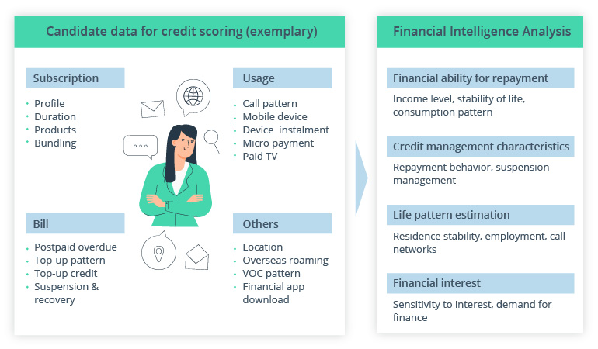
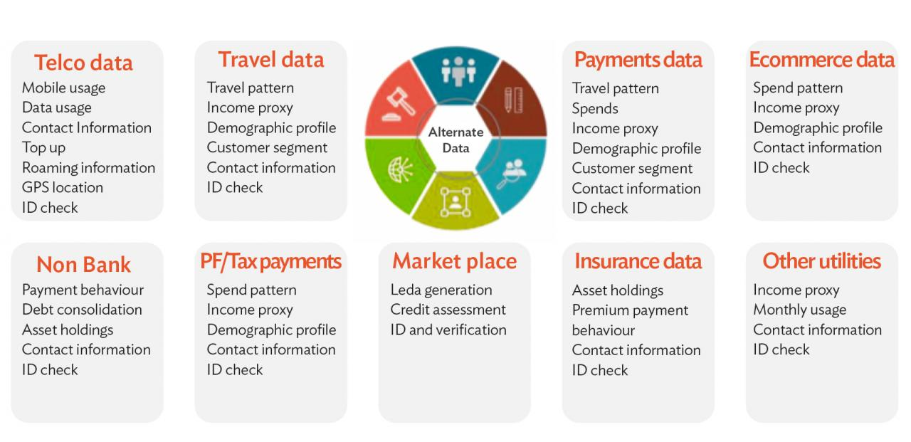
* Use your data wisely to make efficient Decisions using all perspectives
Proposed Solution
.
Notes:
The Objective of this research
To forecast the construction of SFHs in United States, so that it guide construction business community about where to invest ahead of time. Past data can be used analyze complex patterns in SFHs construction across united states (US)
Once we get the prediction, now it is important to know the optimal locations where construction company build plants

Slide 9
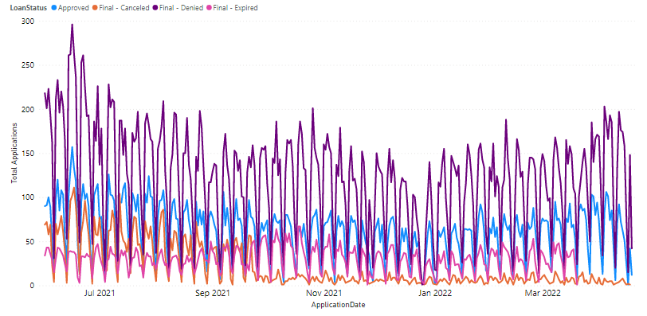
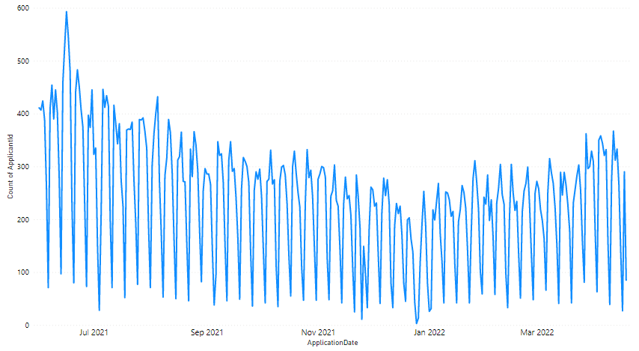
* Volume of Applications Received Monthly
Data Analysis
.
* Volume of Applications Accepted and Rejected
Now this is alarming, because up to 52% of the applications are denied, but Company consume resources!!!!
Notes:
The Objective of this research
To forecast the construction of SFHs in United States, so that it guide construction business community about where to invest ahead of time. Past data can be used analyze complex patterns in SFHs construction across united states (US)
Once we get the prediction, now it is important to know the optimal locations where construction company build plants

Slide 10
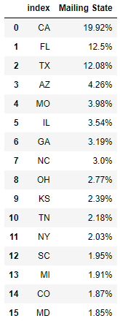
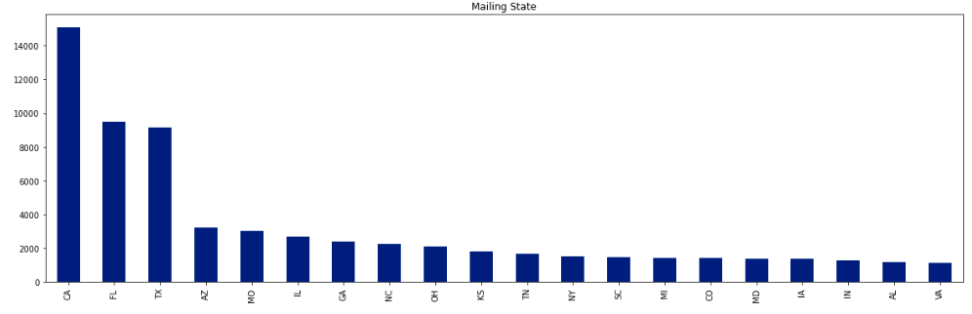
.
Data Distribution
.
Mailing State of Applicant
Notes:
The Objective of this research
To forecast the construction of SFHs in United States, so that it guide construction business community about where to invest ahead of time. Past data can be used analyze complex patterns in SFHs construction across united states (US)
Once we get the prediction, now it is important to know the optimal locations where construction company build plants

Slide 11
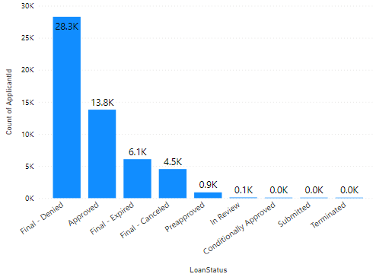
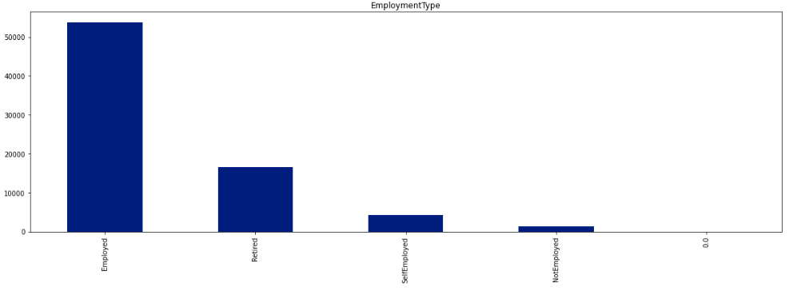
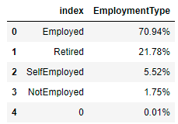
.
Data Distribution
.
Employment Type
Notes:
The Objective of this research
To forecast the construction of SFHs in United States, so that it guide construction business community about where to invest ahead of time. Past data can be used analyze complex patterns in SFHs construction across united states (US)
Once we get the prediction, now it is important to know the optimal locations where construction company build plants

Slide 12
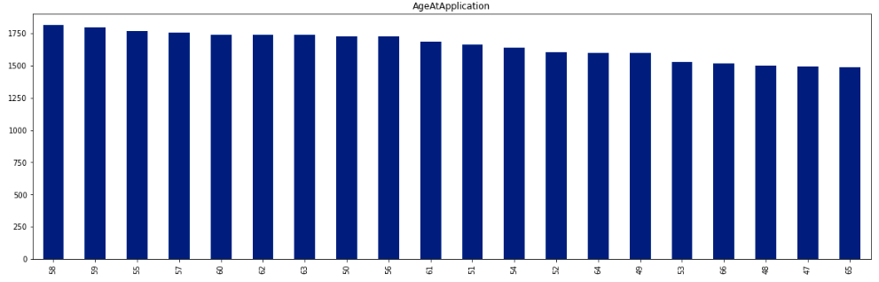
.
Data Distribution
.
Age of the Applicant at the time of application submission
Notes:
The Objective of this research
To forecast the construction of SFHs in United States, so that it guide construction business community about where to invest ahead of time. Past data can be used analyze complex patterns in SFHs construction across united states (US)
Once we get the prediction, now it is important to know the optimal locations where construction company build plants

Slide 13
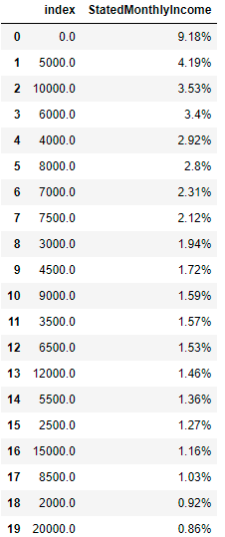
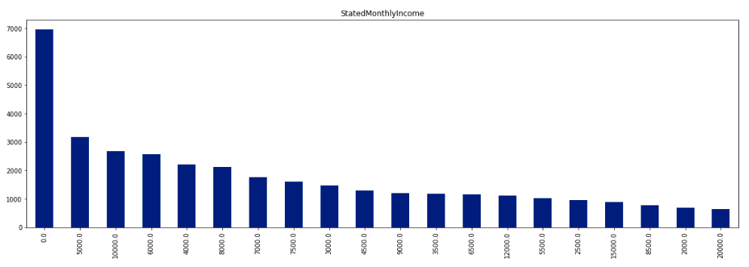
.
Data Distribution
.
Monthly Income Stated by Applicants
Notes:
The Objective of this research
To forecast the construction of SFHs in United States, so that it guide construction business community about where to invest ahead of time. Past data can be used analyze complex patterns in SFHs construction across united states (US)
Once we get the prediction, now it is important to know the optimal locations where construction company build plants

Slide 14
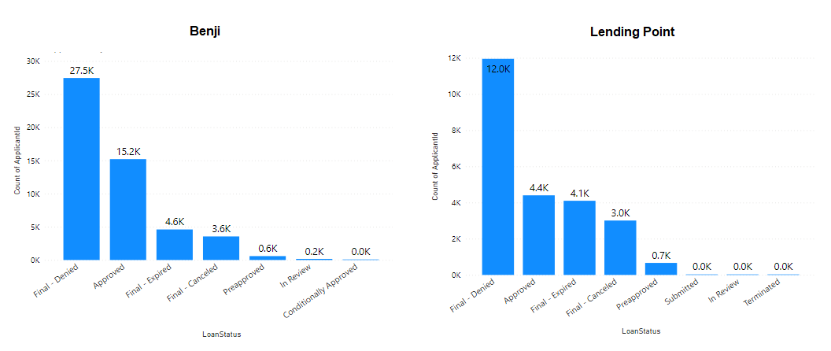
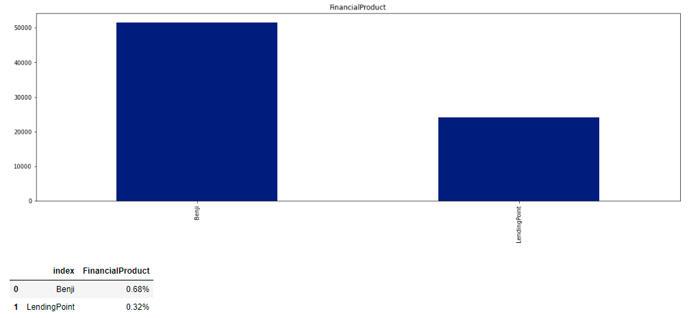
.
Data Distribution
.
Financial Product
Notes:
The Objective of this research
To forecast the construction of SFHs in United States, so that it guide construction business community about where to invest ahead of time. Past data can be used analyze complex patterns in SFHs construction across united states (US)
Once we get the prediction, now it is important to know the optimal locations where construction company build plants

Slide 15
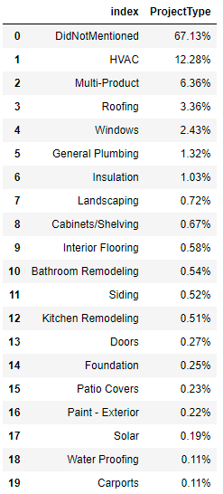
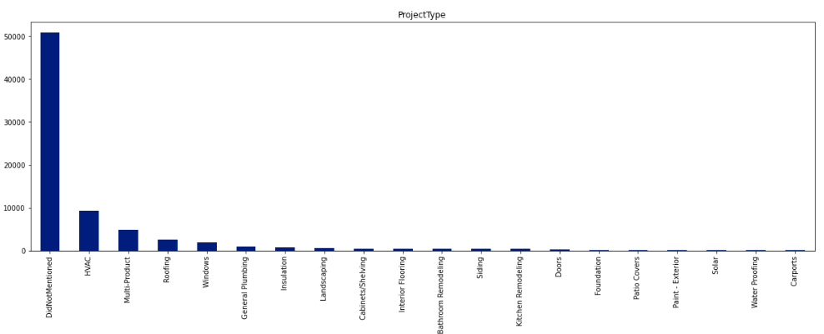
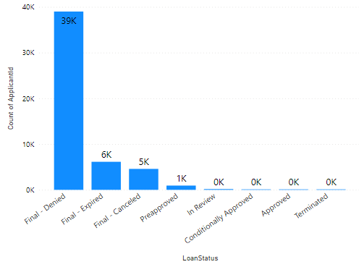
.
Data Distribution
.
Project Type (You can see, mostly loans denied due to not mentioning project type)
Up to 39K applications denied when they don’t mentioned project type
Notes:
The Objective of this research
To forecast the construction of SFHs in United States, so that it guide construction business community about where to invest ahead of time. Past data can be used analyze complex patterns in SFHs construction across united states (US)
Once we get the prediction, now it is important to know the optimal locations where construction company build plants

Slide 16
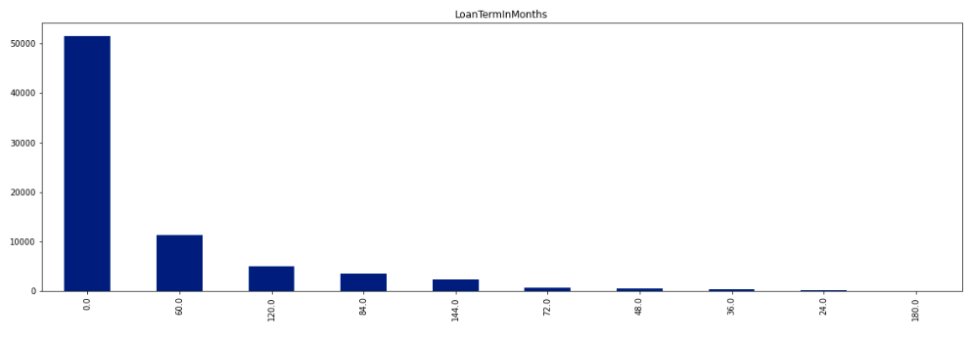
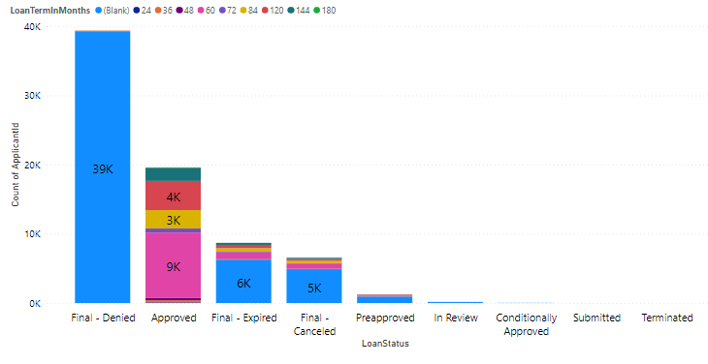
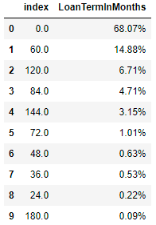
.
Data Distribution
.
Loan Term In Months
Loan terms 60, 84 and 120 more likely to be accepted
Notes:
The Objective of this research
To forecast the construction of SFHs in United States, so that it guide construction business community about where to invest ahead of time. Past data can be used analyze complex patterns in SFHs construction across united states (US)
Once we get the prediction, now it is important to know the optimal locations where construction company build plants

Slide 17
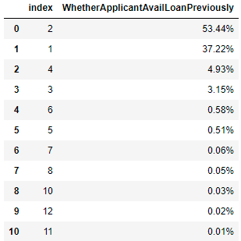
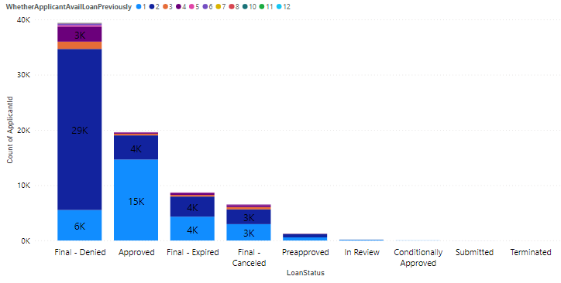
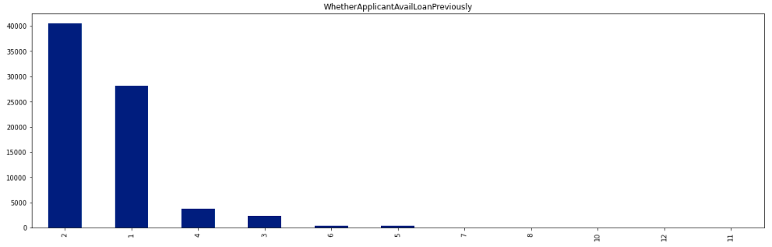
.
Data Distribution
.
How many times applicant applied previously for loan?
Mostly the applications accepted, when you have not previously applied for loan
Notes:
The Objective of this research
To forecast the construction of SFHs in United States, so that it guide construction business community about where to invest ahead of time. Past data can be used analyze complex patterns in SFHs construction across united states (US)
Once we get the prediction, now it is important to know the optimal locations where construction company build plants

Slide 18
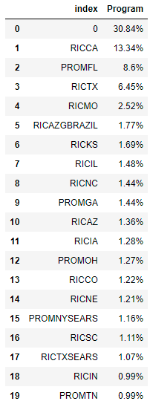
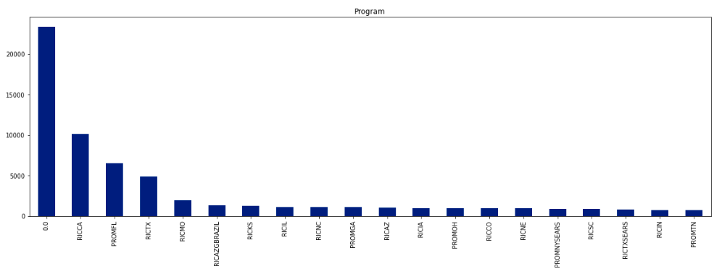
.
Data Distribution
.
Program
Notes:
The Objective of this research
To forecast the construction of SFHs in United States, so that it guide construction business community about where to invest ahead of time. Past data can be used analyze complex patterns in SFHs construction across united states (US)
Once we get the prediction, now it is important to know the optimal locations where construction company build plants

Slide 19
Features used for Modeling
.
Features used for modeling are:-
Applicant Generic Features:-
Mailing State, EmploymentType, AgeAtApplication, StatedMonthlyIncome, FinancialProduct, ApplicationDateDim, ProjectType, Property State, RequestedAmount, LoanTermInMonths, WhetherApplicantAvailLoanPreviously, MonthlyPayment, InterestRate
Applicant Scoring Features (I also tried with these features):-
TUFICO, XPNBK, DecisionFICOScore, DecisionBKScore, Program, APR, BoostList, BenjiDealerFeeDiscountRate, HERODealerFeeDiscountRate
These features can be used – but in reality some of these takes time to calculate
70% data is used for training machine learning algorithm and 30% for testing
Notes:
The Objective of this research
To forecast the construction of SFHs in United States, so that it guide construction business community about where to invest ahead of time. Past data can be used analyze complex patterns in SFHs construction across united states (US)
Once we get the prediction, now it is important to know the optimal locations where construction company build plants

Slide 20
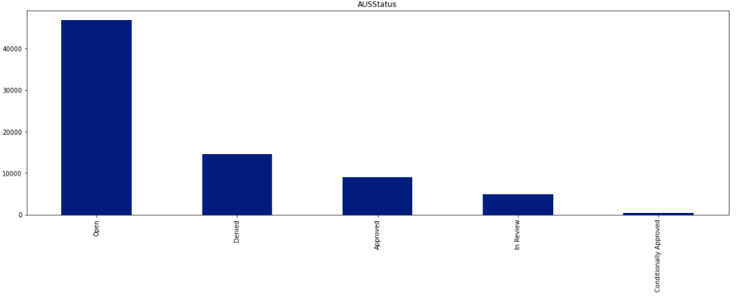
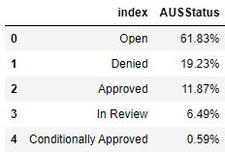
.
Use Case 1
.
In this use case, we predict AUSStatus of loan using features discussed, using Random Forest Classification Technique (Supervised Machine Learning Algorithm).
Notes:
The Objective of this research
To forecast the construction of SFHs in United States, so that it guide construction business community about where to invest ahead of time. Past data can be used analyze complex patterns in SFHs construction across united states (US)
Once we get the prediction, now it is important to know the optimal locations where construction company build plants

Slide 21
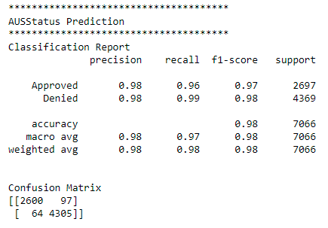
.
Loan AUSStatus Prediction
.
We consider only Approved and Denied Data for training Machine Learning Algorithm
Model Performance:-
An Accurate Model has been trained, which correctly classify data up to 98% accuracy
Correctly Classifying Power
Notes:
The Objective of this research
To forecast the construction of SFHs in United States, so that it guide construction business community about where to invest ahead of time. Past data can be used analyze complex patterns in SFHs construction across united states (US)
Once we get the prediction, now it is important to know the optimal locations where construction company build plants

Slide 22
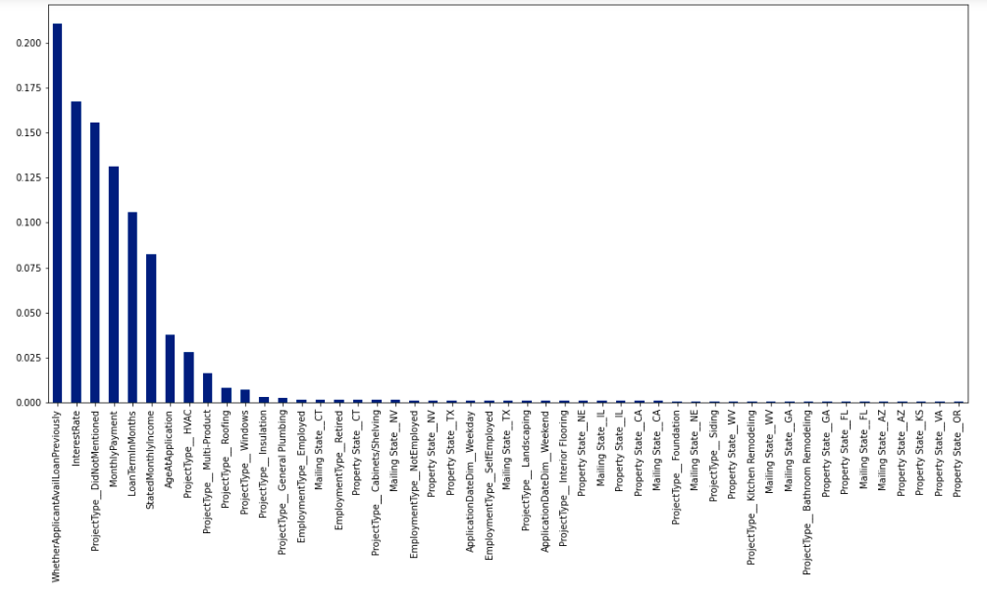
.
Loan AUSStatus Prediction
.
Important Features are:-
Applicant Previous Loan
Interest Rate
Project Type (Mentioned?)
Monthly Payment
Loan Terms Month
Monthly Income of User
Age of Applicant
Notes:
The Objective of this research
To forecast the construction of SFHs in United States, so that it guide construction business community about where to invest ahead of time. Past data can be used analyze complex patterns in SFHs construction across united states (US)
Once we get the prediction, now it is important to know the optimal locations where construction company build plants

Slide 23
.
Loan AUSStatus Prediction
.
Conclusion
An applicant, generally if applied more than twice have high probability of rejection
When applicant didn’t mention project type, there are more chances of being rejection
Large monthly return payment, increase the probability of acceptance and vice versa
Return duration of less than 100 months have high probability of application acceptance
High monthly income or stable business increase chances of getting loan and vice versa
Type of Project mentioned in application is very important
Notes:
The Objective of this research
To forecast the construction of SFHs in United States, so that it guide construction business community about where to invest ahead of time. Past data can be used analyze complex patterns in SFHs construction across united states (US)
Once we get the prediction, now it is important to know the optimal locations where construction company build plants

Slide 24
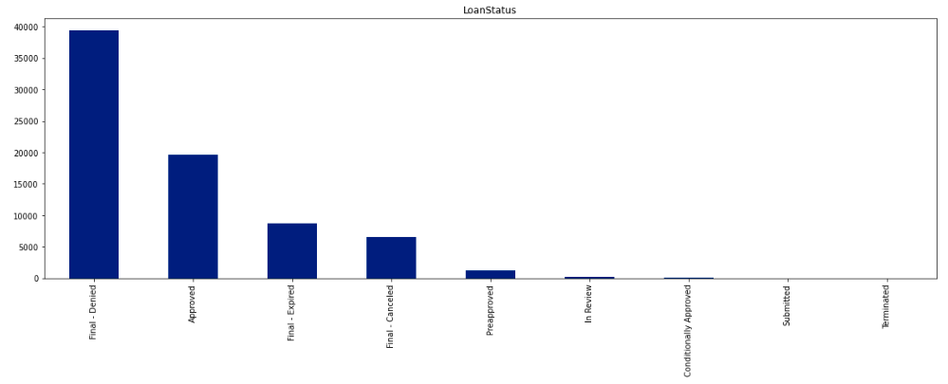
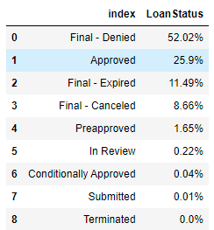
.
Use Case 2
.
In this use case, we predict Loan Status using features discussed, using Random Forest Classification Technique (Supervised Machine Learning Algorithm).
Notes:
The Objective of this research
To forecast the construction of SFHs in United States, so that it guide construction business community about where to invest ahead of time. Past data can be used analyze complex patterns in SFHs construction across united states (US)
Once we get the prediction, now it is important to know the optimal locations where construction company build plants

Slide 25
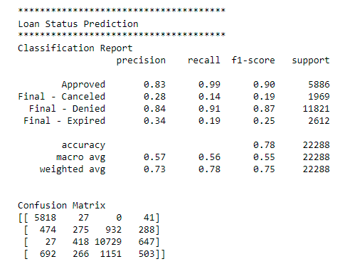
.
Loan Status Prediction
.
We consider only Denied, Accepted, Expired and Cancelled Data for training Machine Learning Algorithm
Model Performance:-
An Accurate Model has been trained, which correctly classify data up to 78% accuracy
Correctly Classifying Power
Notes:
The Objective of this research
To forecast the construction of SFHs in United States, so that it guide construction business community about where to invest ahead of time. Past data can be used analyze complex patterns in SFHs construction across united states (US)
Once we get the prediction, now it is important to know the optimal locations where construction company build plants

Slide 26
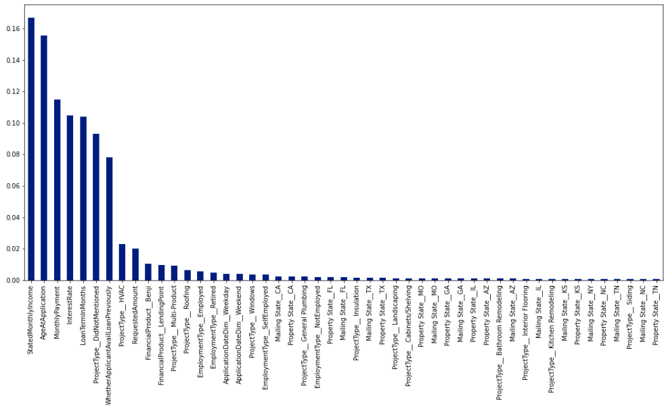
.
Loan Status Prediction
.
Important Features are:-
Monthly Income
Age of Applicant
Monthly Payment (Return)
Interest Rate
Loan terms in Months
Project Type (Work)
Applicant Previous Loan
Notes:
The Objective of this research
To forecast the construction of SFHs in United States, so that it guide construction business community about where to invest ahead of time. Past data can be used analyze complex patterns in SFHs construction across united states (US)
Once we get the prediction, now it is important to know the optimal locations where construction company build plants

Slide 27
.
Loan Status Prediction
.
Conclusion
High monthly income or stable business increase chances of getting loan and vice versa
Very large monthly return can leads to default of an applicants (so select reasonable amount)
High interest rate can leads to cancelation by applicants
Return duration of less than 100 months have high probability of application acceptance
When applicant didn’t mention project type, there are more chances of being rejection
Type of Project mentioned in application is very important
Notes:
The Objective of this research
To forecast the construction of SFHs in United States, so that it guide construction business community about where to invest ahead of time. Past data can be used analyze complex patterns in SFHs construction across united states (US)
Once we get the prediction, now it is important to know the optimal locations where construction company build plants

Slide 28
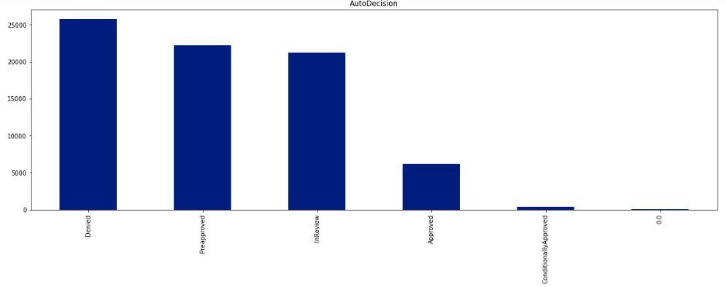
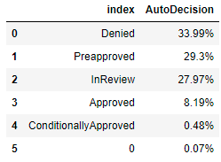
.
Use Case 3
.
In this use case, we predict Auto Decision using features discussed, using Random Forest Classification Technique (Supervised Machine Learning Algorithm).
Notes:
The Objective of this research
To forecast the construction of SFHs in United States, so that it guide construction business community about where to invest ahead of time. Past data can be used analyze complex patterns in SFHs construction across united states (US)
Once we get the prediction, now it is important to know the optimal locations where construction company build plants

Slide 29
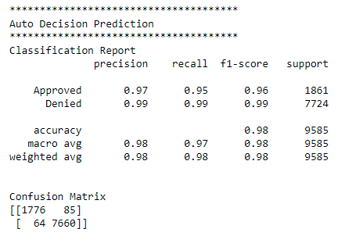
.
Auto Decision Prediction
.
We consider only Approved and Denied Data for training Machine Learning Algorithm
Model Performance:-
An Accurate Model has been trained, which correctly classify data up to 99% accuracy
Correctly Classifying Power
Notes:
The Objective of this research
To forecast the construction of SFHs in United States, so that it guide construction business community about where to invest ahead of time. Past data can be used analyze complex patterns in SFHs construction across united states (US)
Once we get the prediction, now it is important to know the optimal locations where construction company build plants

Slide 30
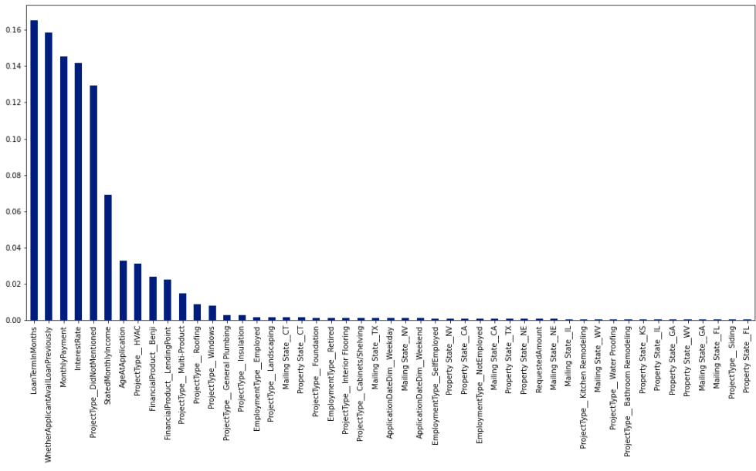
.
Auto Decision Prediction
.
Important Features are:-
Loan Term in Month
Applicant Previous Loans?
Monthly Payment
Project Type
Monthly Income of Applicants
Conclusions Same Previous
Notes:
The Objective of this research
To forecast the construction of SFHs in United States, so that it guide construction business community about where to invest ahead of time. Past data can be used analyze complex patterns in SFHs construction across united states (US)
Once we get the prediction, now it is important to know the optimal locations where construction company build plants

Slide 31
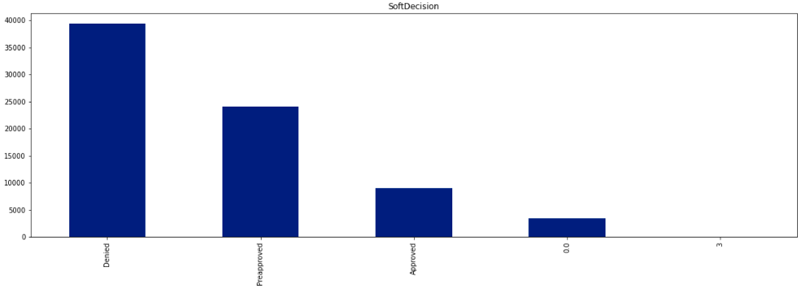
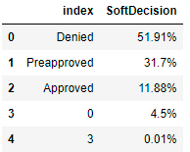
.
Use Case 3
.
In this use case, we predict Soft Decision using features discussed, using Random Forest Classification Technique (Supervised Machine Learning Algorithm).
Notes:
The Objective of this research
To forecast the construction of SFHs in United States, so that it guide construction business community about where to invest ahead of time. Past data can be used analyze complex patterns in SFHs construction across united states (US)
Once we get the prediction, now it is important to know the optimal locations where construction company build plants

Slide 32
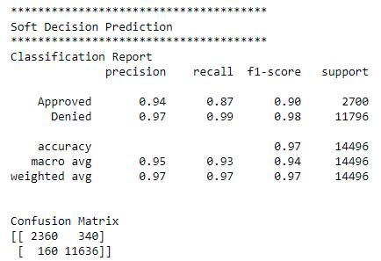
.
Soft Decision Prediction
.
We consider only Approved and Denied Data for training Machine Learning Algorithm
Model Performance:-
An Accurate Model has been trained, which correctly classify data up to 97% accuracy
Correctly Classifying Power
Notes:
The Objective of this research
To forecast the construction of SFHs in United States, so that it guide construction business community about where to invest ahead of time. Past data can be used analyze complex patterns in SFHs construction across united states (US)
Once we get the prediction, now it is important to know the optimal locations where construction company build plants

Slide 33
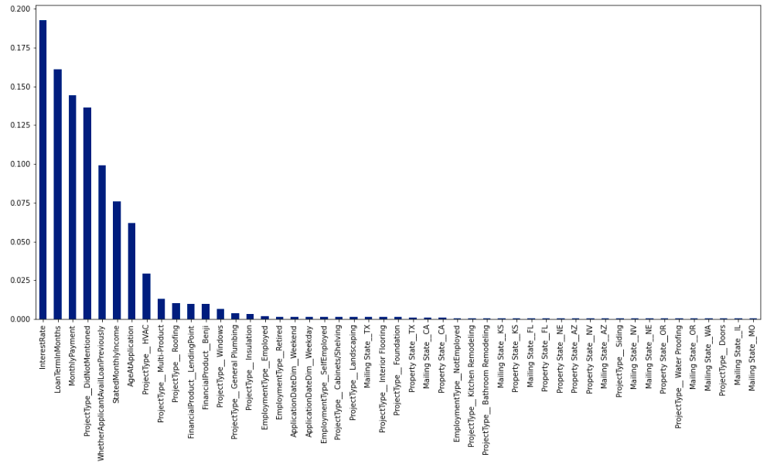
.
Soft Decision Prediction
.
Important Features are:-
Interest Rate
Loan Term in Months
Monthly Payment
Project Type
Previous Loans of Applicants
Applicant Monthly Income
Notes:
The Objective of this research
To forecast the construction of SFHs in United States, so that it guide construction business community about where to invest ahead of time. Past data can be used analyze complex patterns in SFHs construction across united states (US)
Once we get the prediction, now it is important to know the optimal locations where construction company build plants

Slide 34
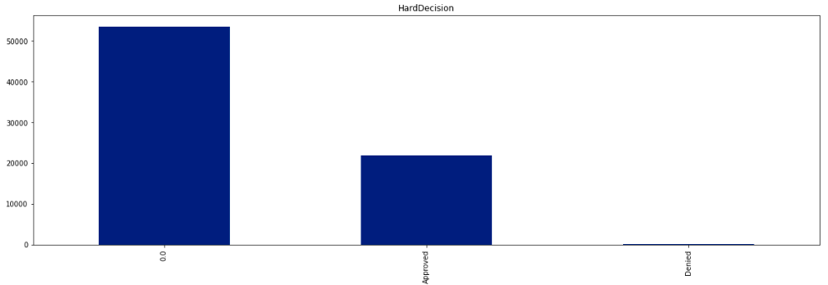
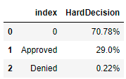
.
Use Case 4
.
In this use case, we predict Hard Decision using features discussed, using Random Forest Classification Technique (Supervised Machine Learning Algorithm).
Notes:
The Objective of this research
To forecast the construction of SFHs in United States, so that it guide construction business community about where to invest ahead of time. Past data can be used analyze complex patterns in SFHs construction across united states (US)
Once we get the prediction, now it is important to know the optimal locations where construction company build plants

Slide 35
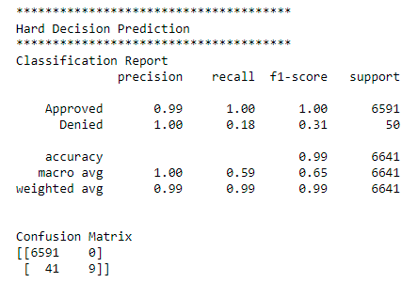
.
Hard Decision Prediction
.
We consider only Approved and Denied Data for training Machine Learning Algorithm
Model Performance:-
An Accurate Model has been trained, which correctly classify data up to 99% accuracy
Correctly Classifying Power
Notes:
The Objective of this research
To forecast the construction of SFHs in United States, so that it guide construction business community about where to invest ahead of time. Past data can be used analyze complex patterns in SFHs construction across united states (US)
Once we get the prediction, now it is important to know the optimal locations where construction company build plants

Slide 36
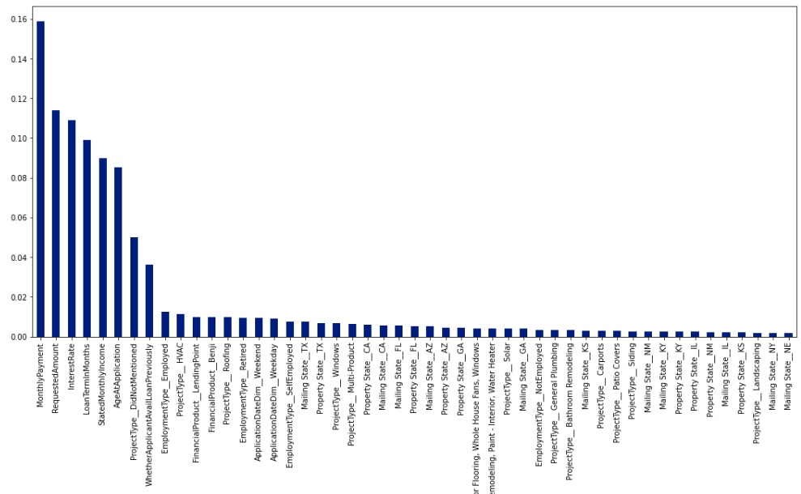
.
Hard Decision Prediction
.
Important Features are:-
Monthly Payment (Return)
Requested Amount
Interest Rate
Loan Term Months
Monthly Income Stated
Notes:
The Objective of this research
To forecast the construction of SFHs in United States, so that it guide construction business community about where to invest ahead of time. Past data can be used analyze complex patterns in SFHs construction across united states (US)
Once we get the prediction, now it is important to know the optimal locations where construction company build plants

Slide 37
.
Hard Decision Prediction
.
Conclusion
Most of the records in hard decision are denied as per data
When large amount is requested, there is a chance of Denial as Hard Decision
High interest rate can leads to cancelation by applicants
Return duration of up to 90 months have high probability of application acceptance
Large monthly income increase chance of acceptance as Hard Decision
Type of Project mentioned in application is very important
Notes:
The Objective of this research
To forecast the construction of SFHs in United States, so that it guide construction business community about where to invest ahead of time. Past data can be used analyze complex patterns in SFHs construction across united states (US)
Once we get the prediction, now it is important to know the optimal locations where construction company build plants

Slide 38
- Once applicant submitted loan application, company takes some times to process application in order to give final decision - That duration of processing vary from case to case, some applications takes small amount of time (good score), some may take up to 3 months. On average an application processing takes up to 14 days as per data.
Use Case 5
.
Machine Learning Algorithm(s) has been used to predict how much time an application can take (in term of days) as per given attributes (discussed previously) of applicants. This will give idea at very early stages to company.
Notes:
The Objective of this research
To forecast the construction of SFHs in United States, so that it guide construction business community about where to invest ahead of time. Past data can be used analyze complex patterns in SFHs construction across united states (US)
Once we get the prediction, now it is important to know the optimal locations where construction company build plants

Slide 39
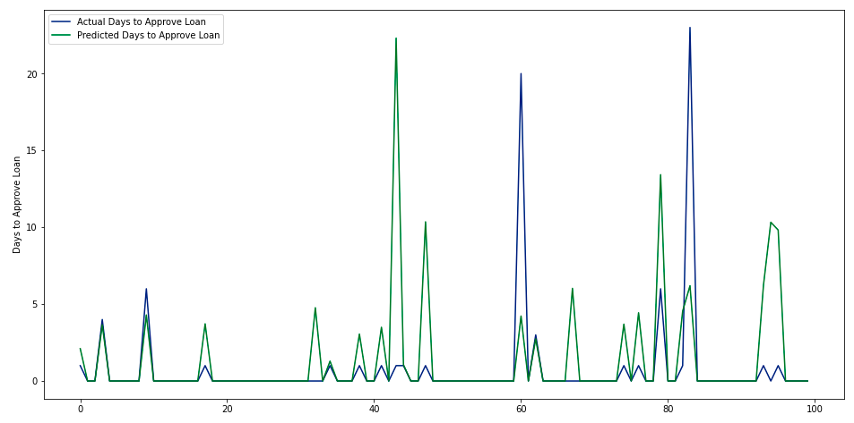
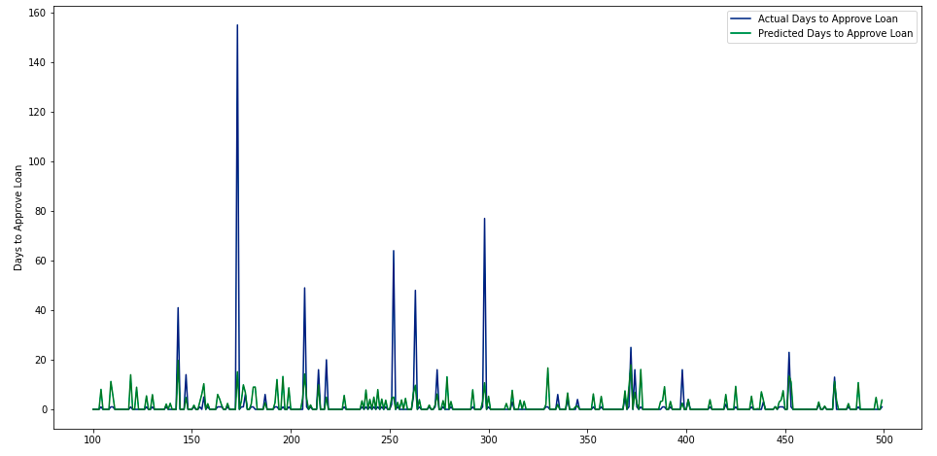
Model successfully learned the pattern and can predict the loan approval duration up to acceptable accuracy (you can see in the image).
Loan Approval Duration Prediction
.
You can the green and blue lines are close to each other which shows that the model is good enough, except for some values (very large duration like 150 days – that will be considered outlier during analysis).
Notes:
The Objective of this research
To forecast the construction of SFHs in United States, so that it guide construction business community about where to invest ahead of time. Past data can be used analyze complex patterns in SFHs construction across united states (US)
Once we get the prediction, now it is important to know the optimal locations where construction company build plants

Slide 40
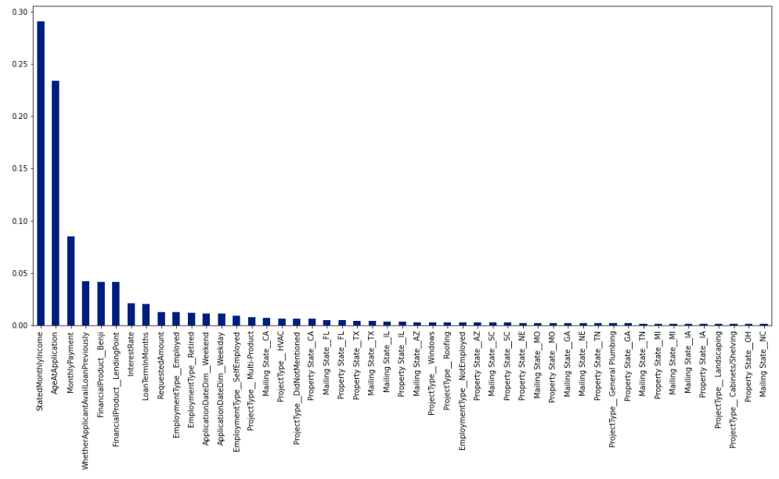
What factors affect the loan approval duration?
Loan Approval Duration Prediction
.
Stated Monthly Income
Monthly Payment (Return)
Applicant Previous Loan
Product Type (Benji?)
Loan Term in Months
Requested Amount
Small Requested Amount takes less days to approve and large amount takes large time
Notes:
The Objective of this research
To forecast the construction of SFHs in United States, so that it guide construction business community about where to invest ahead of time. Past data can be used analyze complex patterns in SFHs construction across united states (US)
Once we get the prediction, now it is important to know the optimal locations where construction company build plants

Slide 41
- As a company, we are interested in finding how much loan (Optimal Value) should be given to applicant based on his own attributes, so that he pay back without going into defaulter stage.
Use Case 6
.
Machine Learning Algorithm(s) has been used to predict how much loan we can give to an application as per given attributes (discussed previously) of applicants. This will give idea at very early stages to company to reduce risk of defaulting.
Notes:
The Objective of this research
To forecast the construction of SFHs in United States, so that it guide construction business community about where to invest ahead of time. Past data can be used analyze complex patterns in SFHs construction across united states (US)
Once we get the prediction, now it is important to know the optimal locations where construction company build plants

Slide 42
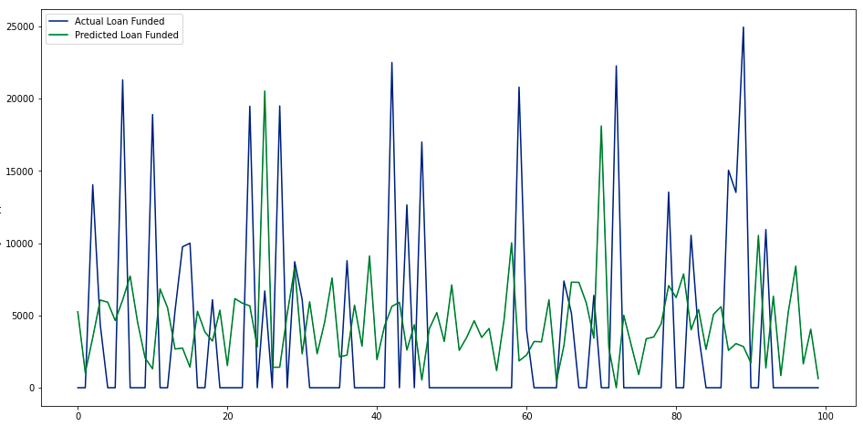

* We have developed a perfect model (machine learning model) which predict how much loan amount should be awarded to applicants (to avoid loan defaults)
Loan Amount Prediction
.
You can the green and blue lines are close to each other which shows that the model is good enough – an accurate model.
Notes:
The Objective of this research
To forecast the construction of SFHs in United States, so that it guide construction business community about where to invest ahead of time. Past data can be used analyze complex patterns in SFHs construction across united states (US)
Once we get the prediction, now it is important to know the optimal locations where construction company build plants

Slide 43

.
Loan Amount Prediction
.
How much loan an applicant will get? Mostly depends on Monthly Income
Loan Amount also increase with increase in monthly payment and vice versa
Based on previous loan history, an applicant can get low or high loan, if the applicant previous record of payment is okay, he will be given loan otherwise low amount
Loan Amount is also closely related to financial product (Benji or Lending Point)
Notes:
The Objective of this research
To forecast the construction of SFHs in United States, so that it guide construction business community about where to invest ahead of time. Past data can be used analyze complex patterns in SFHs construction across united states (US)
Once we get the prediction, now it is important to know the optimal locations where construction company build plants

Slide 44
- As a company, we are also interested in finding how many applications may received next time frame (may be next day/ week/ month/ 6 months). Using this information company will make necessary arrangements.
Use Case 7
.
Machine Learning Algorithm is used to forecast the number of applications in next time frame based on last one month data (by analyzing last 30 days, model predict number of applications).
Notes:
The Objective of this research
To forecast the construction of SFHs in United States, so that it guide construction business community about where to invest ahead of time. Past data can be used analyze complex patterns in SFHs construction across united states (US)
Once we get the prediction, now it is important to know the optimal locations where construction company build plants

Slide 45
Dataset Creation
Possible Loan Applications Forecasting
.
Dataset
Time Series Dataset
Day 1 Applicants
Day 1 Applicants
Day 2 Applicants
Day 3 Applicants
Day 2 Applicants
Day 2 Applicants
Day 3 Applicants
Day 4 Applicants
Day 3 Applicants
Day 3 Applicants
Day 4 Applicants
Day 5 Applicants
Day 4 Applicants
Day 5 Applicants
y - Target
X - Predictor
Day 6 Applicants
y = f(x)
Day 7 Applicants
Loop back: How many previous records are we considering for predicting next. Here loop back is 2, we predict next on basis of last two records
Day N Applicants
Notes:
The Objective of this research
To forecast the construction of SFHs in United States, so that it guide construction business community about where to invest ahead of time. Past data can be used analyze complex patterns in SFHs construction across united states (US)
Once we get the prediction, now it is important to know the optimal locations where construction company build plants

Slide 46


.
Possible Loan Applications Forecasting
.
You can clearly see how perfect forecasting model has been trained.
Model trained on data before Jan 2022, and then test on Data after Dec 2021
Check how close, blue and green lines are, this shows the accuracy of model
85% perfect Model
Notes:
The Objective of this research
To forecast the construction of SFHs in United States, so that it guide construction business community about where to invest ahead of time. Past data can be used analyze complex patterns in SFHs construction across united states (US)
Once we get the prediction, now it is important to know the optimal locations where construction company build plants

Slide 47
- As a company, we are also interested in finding how many applications might be accepted next time frame (may be next day/ week/ month/ 6 months). Using this information company will make necessary arrangements.
Use Case 8
.
Machine Learning Algorithm is used to forecast the number of applications in next time frame based on last one month data (by analyzing last 30 days, model predict number of applications that might approve next time).
Notes:
The Objective of this research
To forecast the construction of SFHs in United States, so that it guide construction business community about where to invest ahead of time. Past data can be used analyze complex patterns in SFHs construction across united states (US)
Once we get the prediction, now it is important to know the optimal locations where construction company build plants

Slide 48


* Dataset created in same as Use Case 7 (We only take approved applicants)
Possible Loan Applications That Will Approve - Forecasting
.
You can clearly see how perfect forecasting model has been trained.
Model trained on data before Jan 2022, and then test on Data after Dec 2021
Check how close, blue and green lines are, this shows the accuracy of model
85% perfect Model
Notes:
The Objective of this research
To forecast the construction of SFHs in United States, so that it guide construction business community about where to invest ahead of time. Past data can be used analyze complex patterns in SFHs construction across united states (US)
Once we get the prediction, now it is important to know the optimal locations where construction company build plants

Slide 49
- As a company, we are also interested in finding how much is needed for next time frame for accepted applicants. Using this information company will make necessary arrangements.
Use Case 9
.
Machine Learning Algorithm is used to forecast the amount required for loan to be funded in next time frame based on last one month data (by analyzing last 30 days, model predict amount required to be funded next time).
Notes:
The Objective of this research
To forecast the construction of SFHs in United States, so that it guide construction business community about where to invest ahead of time. Past data can be used analyze complex patterns in SFHs construction across united states (US)
Once we get the prediction, now it is important to know the optimal locations where construction company build plants

Slide 50


.
Possible Loan Amount Forecasting
.
* Dataset created in same as Use Case 7 (We only take approved Amounts)
You can clearly see how perfect forecasting model has been trained.
Model trained on data before Jan 2022, and then test on Data after Dec 2021
Check how close, blue and green lines are, this shows the accuracy of model
85% perfect Model
Notes:
The Objective of this research
To forecast the construction of SFHs in United States, so that it guide construction business community about where to invest ahead of time. Past data can be used analyze complex patterns in SFHs construction across united states (US)
Once we get the prediction, now it is important to know the optimal locations where construction company build plants

Slide 51


.
Applicants Forecasting for Benji and Lending Point
.
* Dataset created in same as Use Case 8
Notes:
The Objective of this research
To forecast the construction of SFHs in United States, so that it guide construction business community about where to invest ahead of time. Past data can be used analyze complex patterns in SFHs construction across united states (US)
Once we get the prediction, now it is important to know the optimal locations where construction company build plants

Slide 52

.
Fraud/ Anomaly Detection
.
As contractors involved in this loan process, so as a company we are interested to have insights about the contractors behavior. Identify those contractors which behaves differently than others. We can further analyze contractors’ behavior in order to identify whether they are fraudulent or not?
Notes:
The Objective of this research
To forecast the construction of SFHs in United States, so that it guide construction business community about where to invest ahead of time. Past data can be used analyze complex patterns in SFHs construction across united states (US)
Once we get the prediction, now it is important to know the optimal locations where construction company build plants

Slide 53

.
Fraud/ Anomaly Detection
.
1773 of the contractors process 18 applications – but 134 processed up to 330 applications on average
1773 of the contractors have 5 applications approved on average – but 134 contractors have 86 approved applications
1773 of the contractors have small ratio of acceptance, cancellation, rejection etc. – while 134 contractors large such ratios
Most of the contractors deals in 1 US State only – while some contractors deals in more than 1 US State
1773 of the contractors have 2 applicants per day – while 134 contractors have up to 4 applicants per day
1773 of the contractors have at max 4 applicants per day – while 134 contractors have up to 11 applicants per day at Maximum (Observed)
Notes:
The Objective of this research
To forecast the construction of SFHs in United States, so that it guide construction business community about where to invest ahead of time. Past data can be used analyze complex patterns in SFHs construction across united states (US)
Once we get the prediction, now it is important to know the optimal locations where construction company build plants

Slide 54

.
Fraud/ Anomaly Detection
.
1773 of the contractors small denial, cancellation ratio – while 134 have large number of denied applications
1773 of the contractors small number of applicants per day – while 134 have large number of applicants per day
1773 of the contractors have comparatively small requested loan amounts – while 134 have large loan amounts
As a company, these 134 contractors needs to be analyzed, in order to make sure that they are not involved in any anomalous/ suspicious activity
Notes:
The Objective of this research
To forecast the construction of SFHs in United States, so that it guide construction business community about where to invest ahead of time. Past data can be used analyze complex patterns in SFHs construction across united states (US)
Once we get the prediction, now it is important to know the optimal locations where construction company build plants

Slide 55
.
Results/ Predictions
.
In May 2022, company may receive around 6973 applications for loan
In May 2022, company might accept around 1694 applications for loan
In May 2022, company might give around 18, 868,715 USD in Loans
In May 2022, company may have 4715 applications for Benji
In May 2022, company may have 2193 applications for Lending Point
Notes:
The Objective of this research
To forecast the construction of SFHs in United States, so that it guide construction business community about where to invest ahead of time. Past data can be used analyze complex patterns in SFHs construction across united states (US)
Once we get the prediction, now it is important to know the optimal locations where construction company build plants

Slide 56
Machine Learning State of the Art Algorithms are successfully used to predict whether given loan application will be approved or rejected, and how much loan should be funded, in how many days application will be accepted or rejected, number of loan applications next month, approved applications forecasting, loans funds required next month and Outlier/ Anomalous contractors. We have achieved results up to 99% accuracy. System can be very effective in term of saving company resources (time plus money), hence increase customer satisfaction in term of quick service (customers will have quick feedback about their loan applications)
Conclusion
.
Notes:
The Objective of this research
To forecast the construction of SFHs in United States, so that it guide construction business community about where to invest ahead of time. Past data can be used analyze complex patterns in SFHs construction across united states (US)
Once we get the prediction, now it is important to know the optimal locations where construction company build plants

Slide 57

Conclusion
i
Notes:
The Objective of this research
To forecast the construction of SFHs in United States, so that it guide construction business community about where to invest ahead of time. Past data can be used analyze complex patterns in SFHs construction across united states (US)
Once we get the prediction, now it is important to know the optimal locations where construction company build plants

